Slide 1
Module 18
Organising and Planning for Effective Implementation
By: Dr Shahinaz Abdellatif

Slide 2
Objective of this session
1. To examine the fit between a business’s competitive and marketing strategies and the organisational structures, policies, processes and plans necessary to implement those strategies

Slide 3
Organizational Fit
Organisational fit – the fit between a business’s competitive and marketing strategies and the organisational structures, policies, processes, and plans necessary to effectively implement those strategies.

Slide 4
Factors influence Implementation
Three aspects of the corporate business unit relationship that can affect the SBU’s success in implementing a particular competitive strategy:
1. The degree of autonomy provided each business unit manager.
2. The degree to which the business unit shares functional programmes and facilities with other units.
3. The manner in which the corporation evaluates and rewards the performance of its SBU managers.

Slide 5
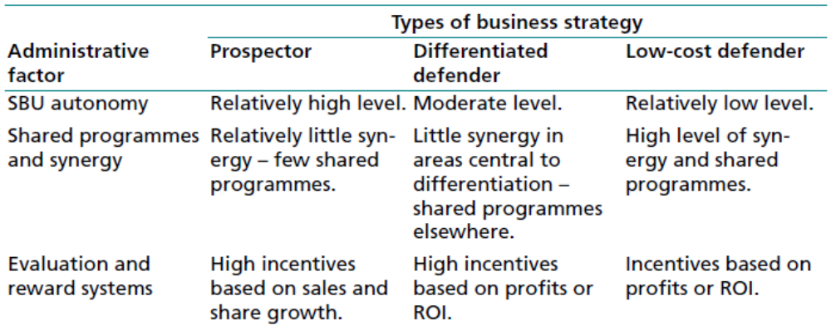
Administrative factors related to the successful implementation of business strategies

Slide 6
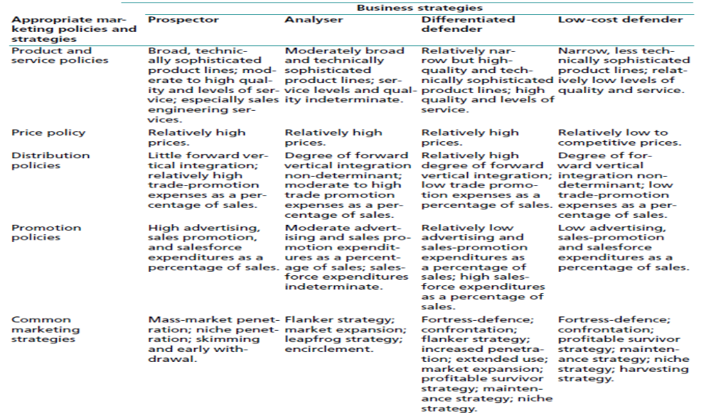
Fit between Business Strategies & Marketing Programme

Slide 7
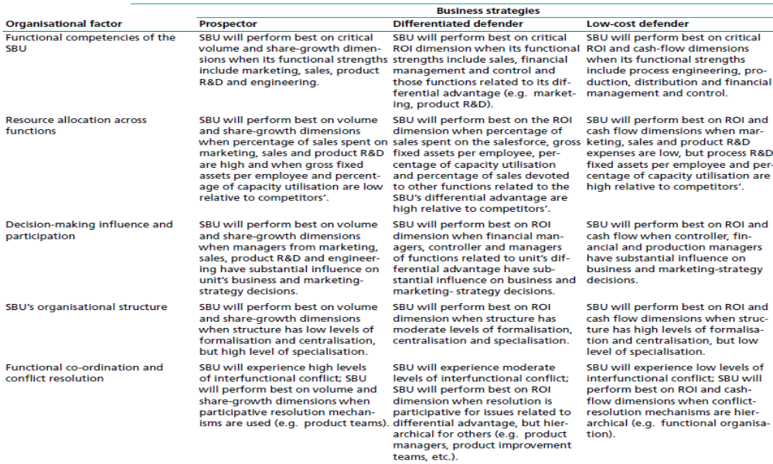

Slide 8
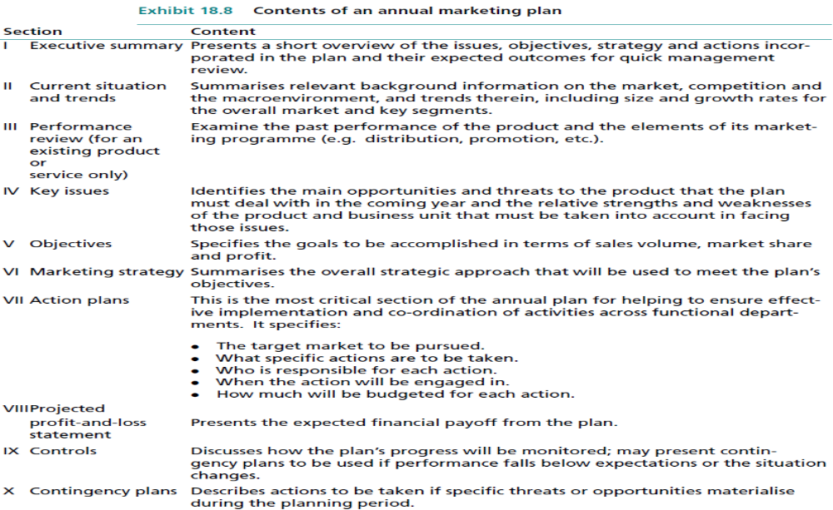
Marketing Plan

